Slide 1
Measurement Feature
Document

Slide 2
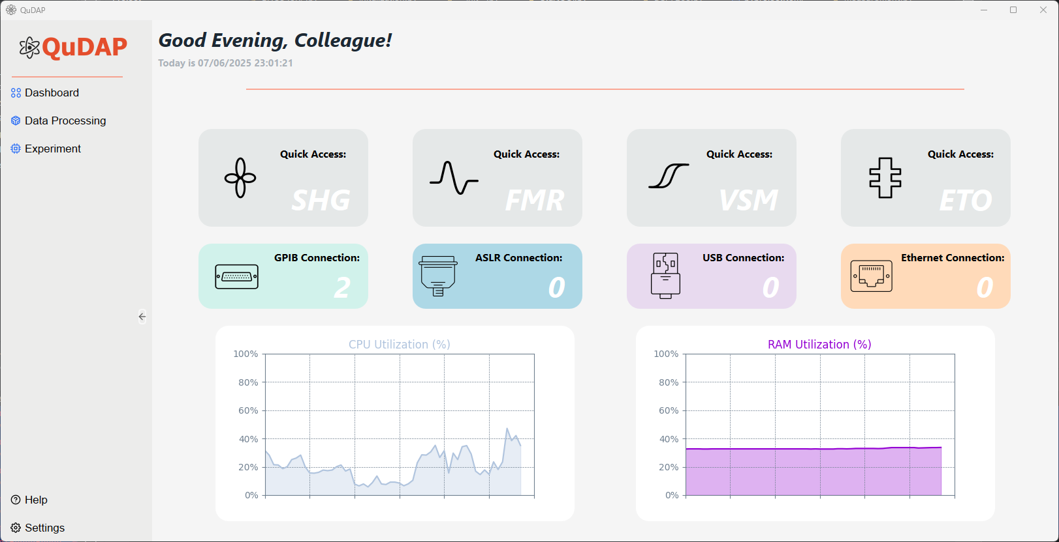
1. This is the Initial Dashboard
2. This part of the dashboard is to initialize the measurement – click any of the icon in the red box

Slide 3
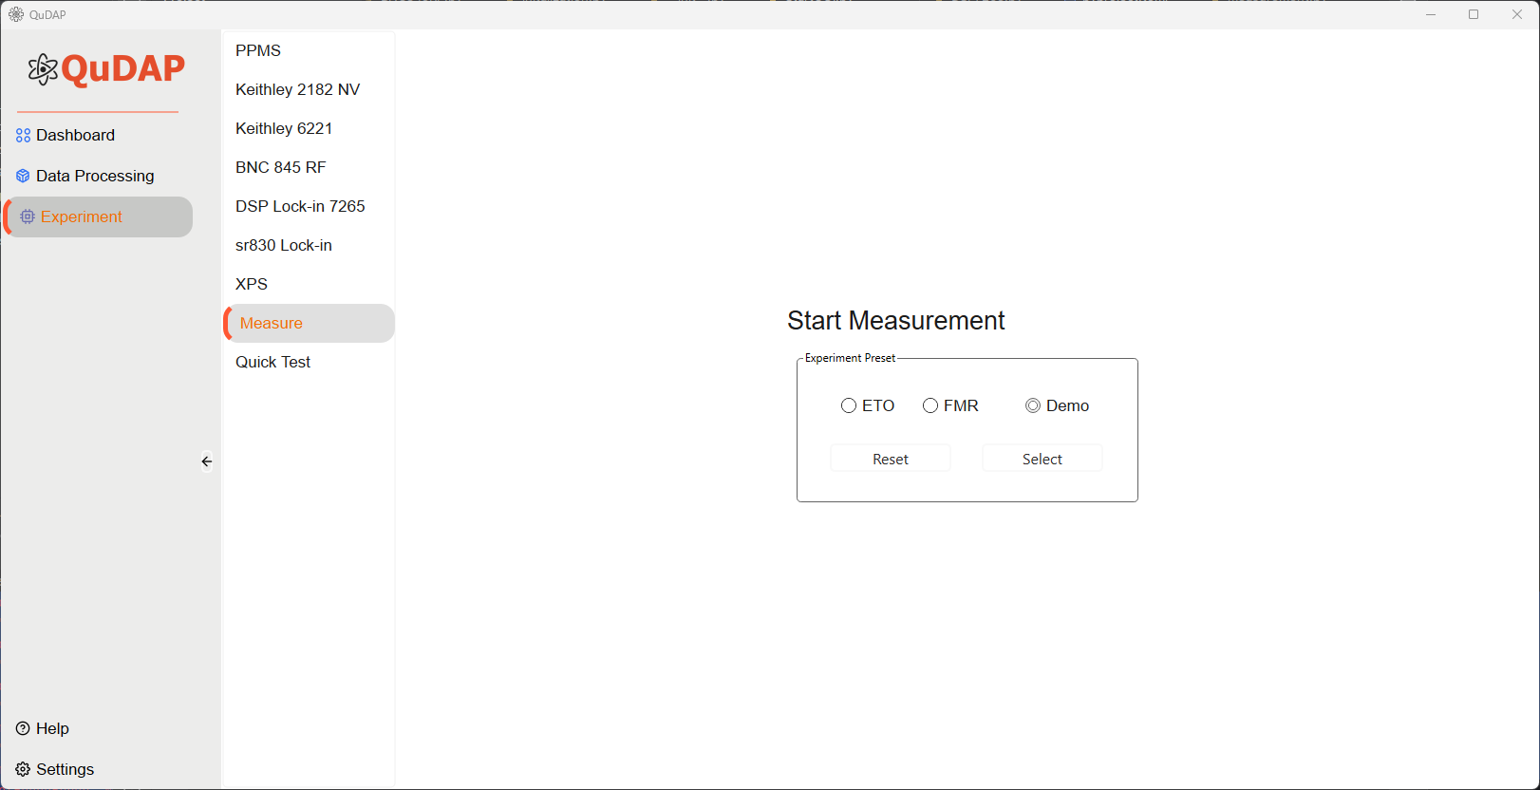
1. Direct to the measurement window
3. Select ‘Demo’
4. Press ‘Select’
2. These are types of the measurement users can select – currently only support ETO and Demo

Slide 4
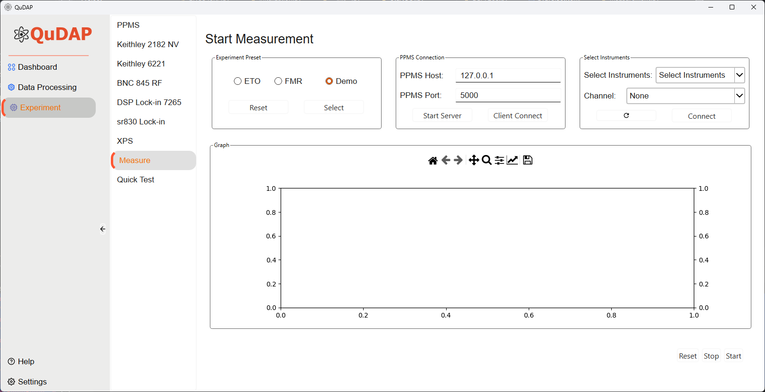
Widget of PPMS instrument Connection
Widget of customized instruments
Widget of measurement selection
2.
3.
Widget of Plotting Window
Start the connection for PPMS
Press ‘Start Server’
Press ‘Client Connection’
Measurement button

Slide 5
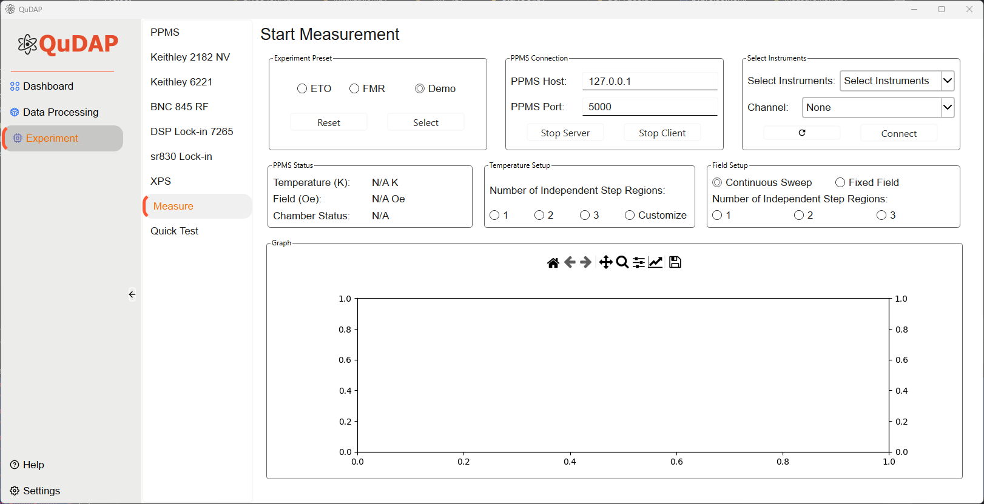
New widgets pop up for PPMS configuration

Slide 6
Widget of PPMS instrument Connection
Widget of customized instruments
Widget of measurement selection
2.
3.
Widget of Plotting Window
Start the connection for PPMS
Press ‘Start Server’
Press ‘Client Connection’
Measurement button

Slide 7
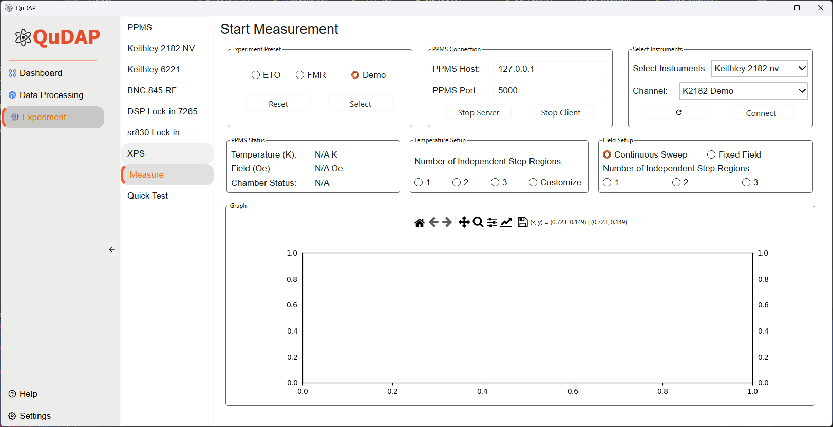
Widget of PPMS instrument Connection
Widget of customized instruments
2.
Widget of measurement selection
3.
4.
Widget of Plotting Window
Start the connection for customized instruments
Select ‘Keithley 2181 nv’
Select Channel ‘K2182 Demo’
Press ‘Connect’
A confirmation window will pop up

Slide 8
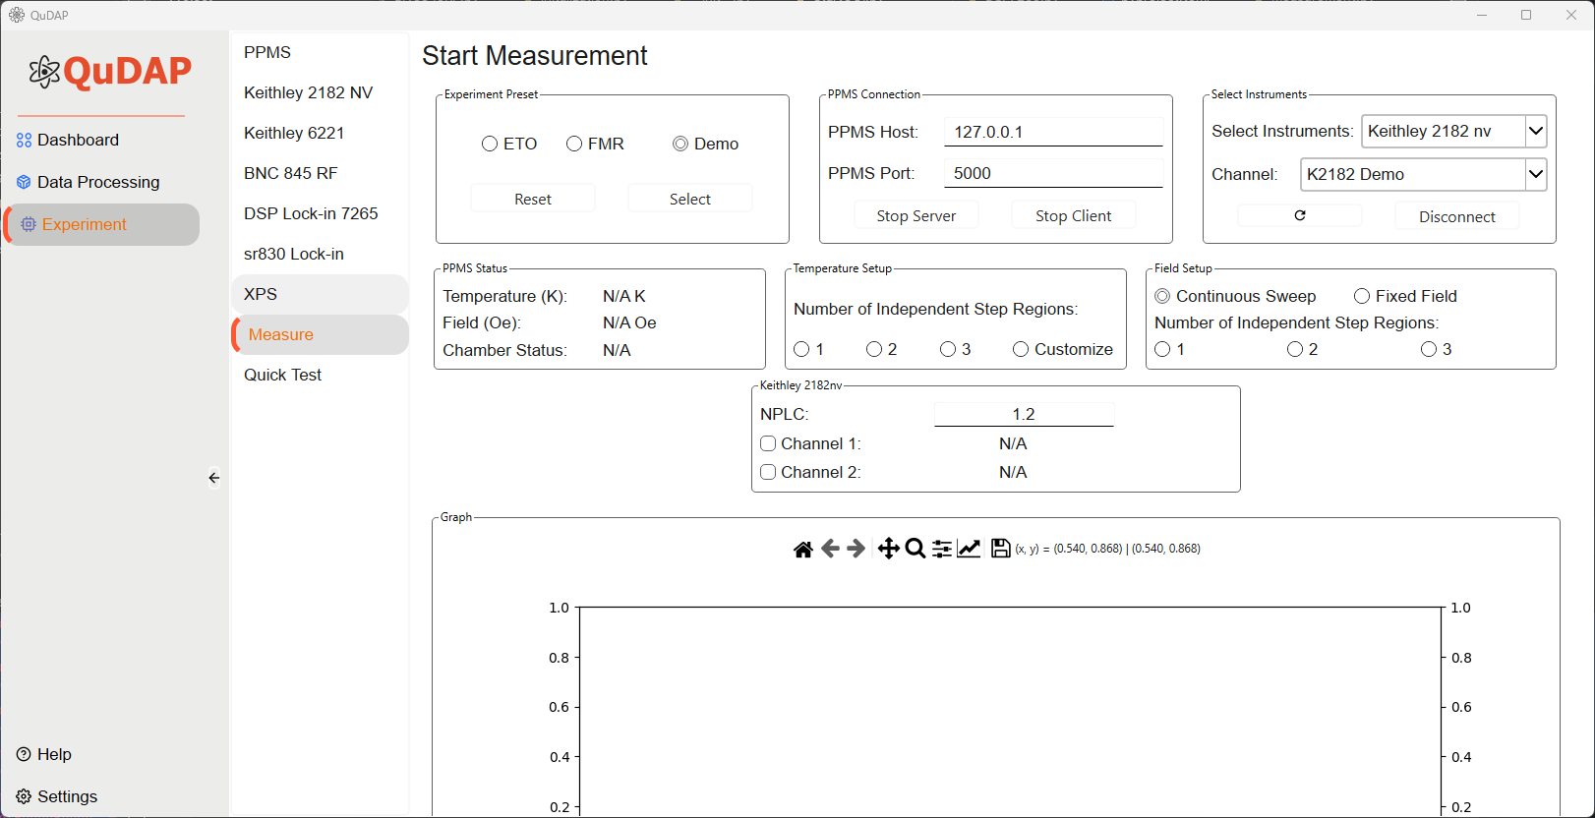
Widget of PPMS instrument Connection
Widget of customized instruments
Widget of measurement selection
Configuration Widget for customized instruments
Widget of Plotting Window
New widget of previous connected instruments shows up

Slide 9
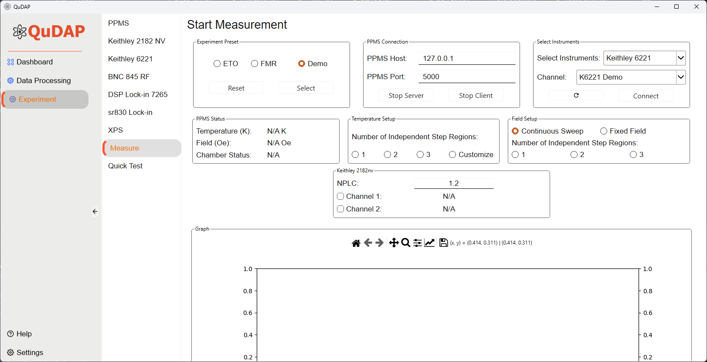
Widget of PPMS instrument Connection
Widget of customized instruments
2.
Widget of measurement selection
3.
4.
Configuration Widget for customized instruments
Widget of Plotting Window
Start the connection for customized instruments
Select ‘Keithley 6221’
Select Channel ‘K6221 Demo’
Press ‘Connect’
A confirmation window will pop up

Slide 10
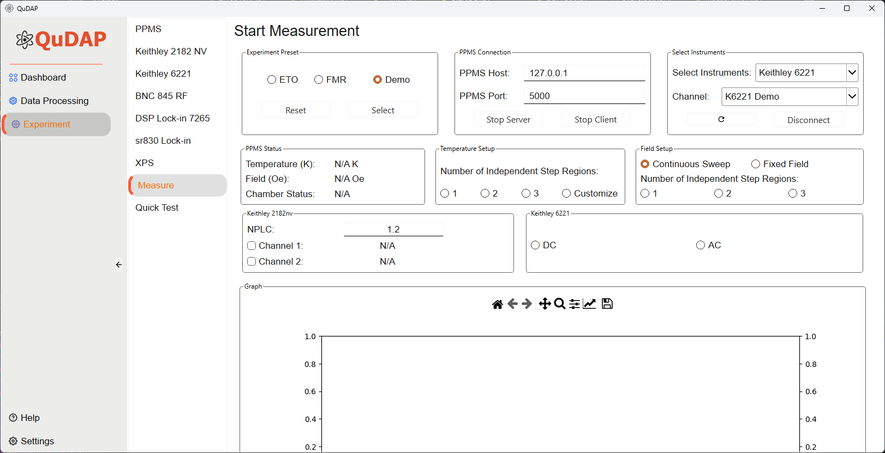
Widget of PPMS instrument Connection
Widget of customized instruments
Widget of measurement selection
Configuration Widget for customized instruments
Widget of Plotting Window
New widget of previous connected instruments shows up

Slide 11
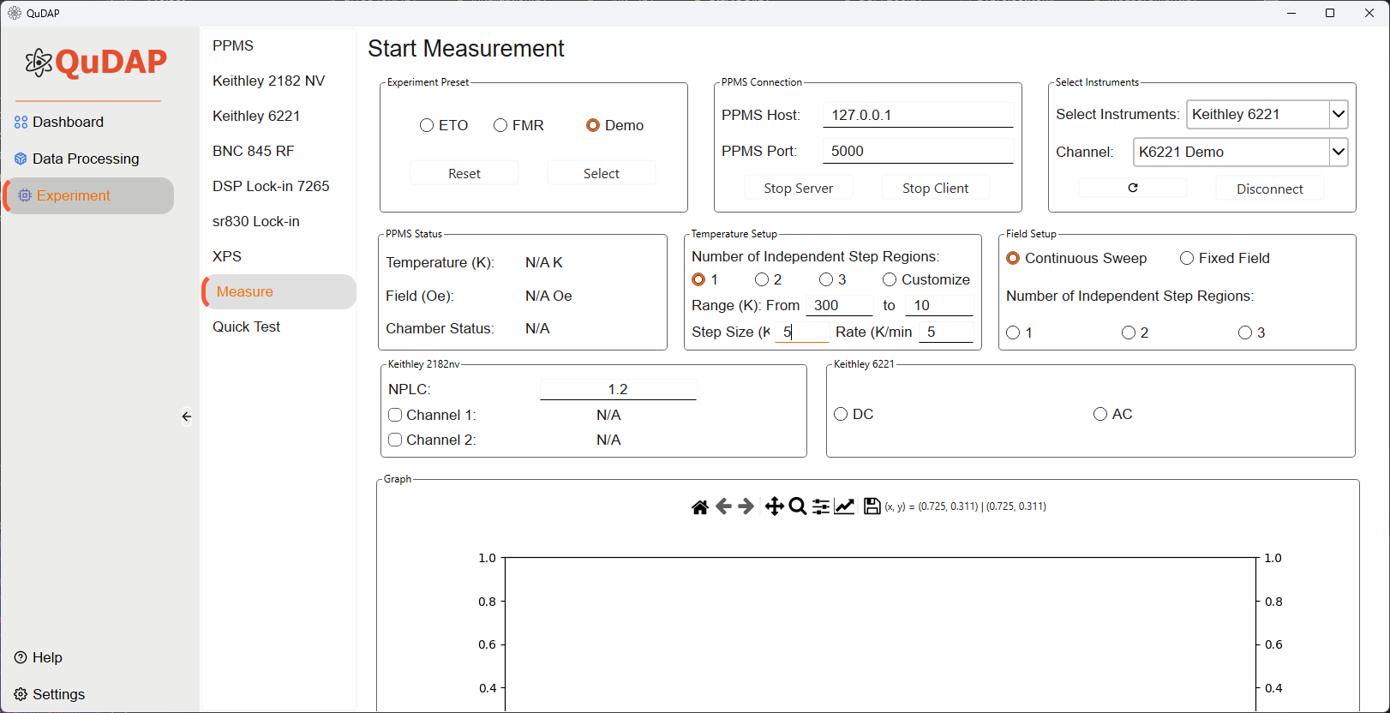
Configure the experiment temperature
Users can config how they want to setup the temperate either in range or single measurement
This is used for temperature dependence measurement

Slide 12
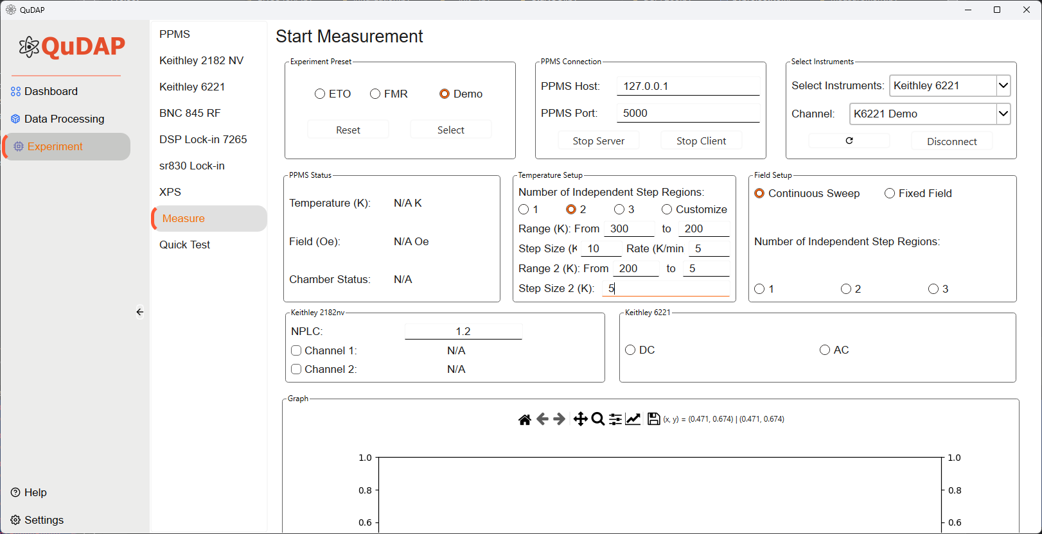
Configure the experiment temperature
Users can config how they want to setup the temperate either in range or single measurement
This is used for temperature dependence measurement

Slide 13
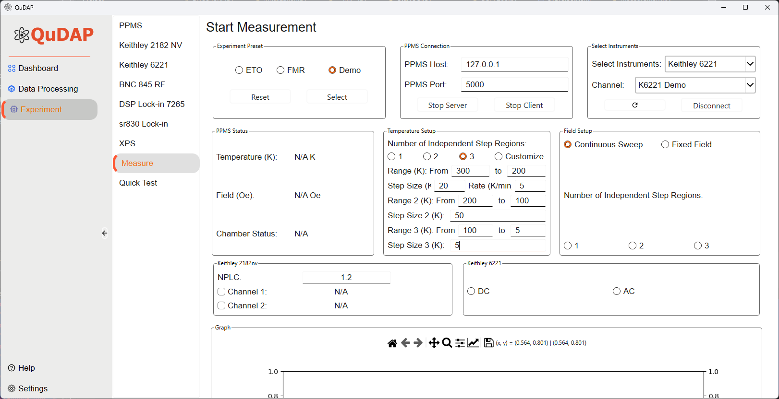
Configure the experiment temperature
Users can config how they want to setup the temperate either in range or single measurement
This is used for temperature dependence measurement

Slide 14
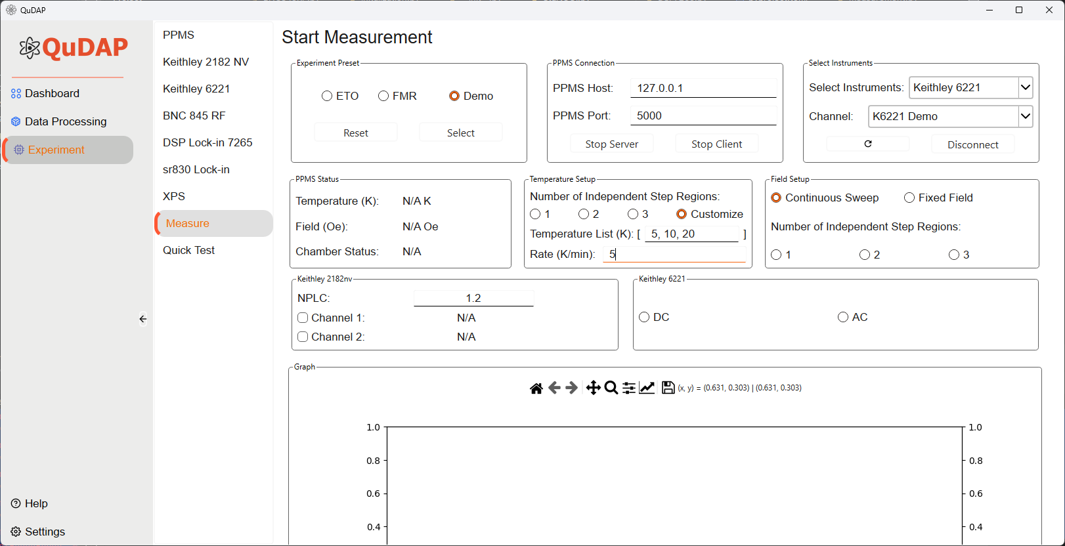
Use this setup for demo purpose
Configure the experiment temperature
Users can config how they want to setup the temperate either in range or single measurement
This is used for temperature dependence measurement
Note: In this customize setting, user can choose multiples/single temperature/s setup

Slide 15
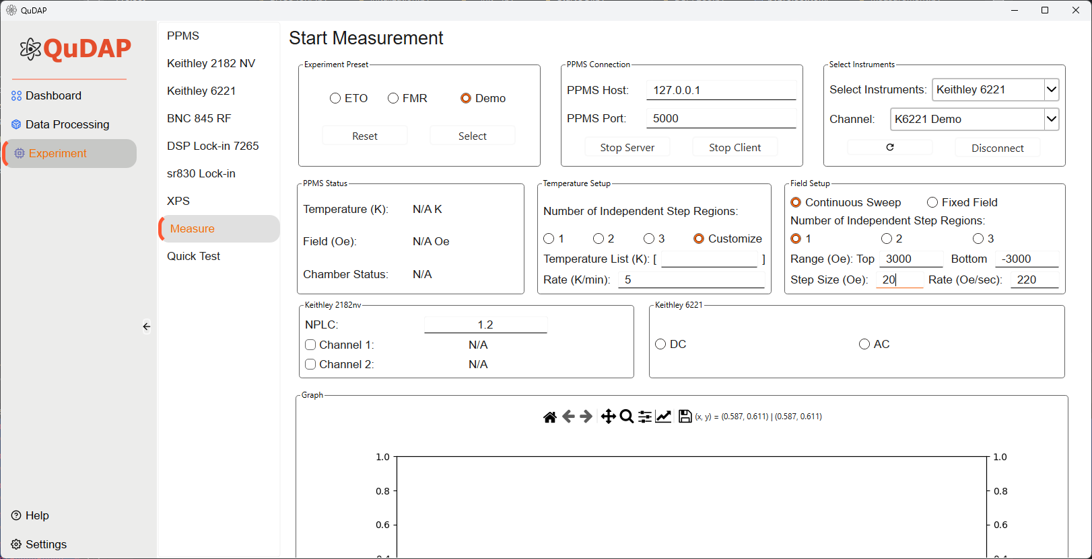
Configure the experiment Field
The software comes with two modes, ‘Continuous Sweep’ or ‘Fixed Field
For continuous sweeping, user will setup the top and the bottom field as well as the rate of the sweeping.
The field will be continuously ramping up or down without stopping
The fixed field configuration is for users who want to have a precise and ordered field reading
The field setting is based on step size which will stable at one field and do the measurement and continuous to next step

Slide 16
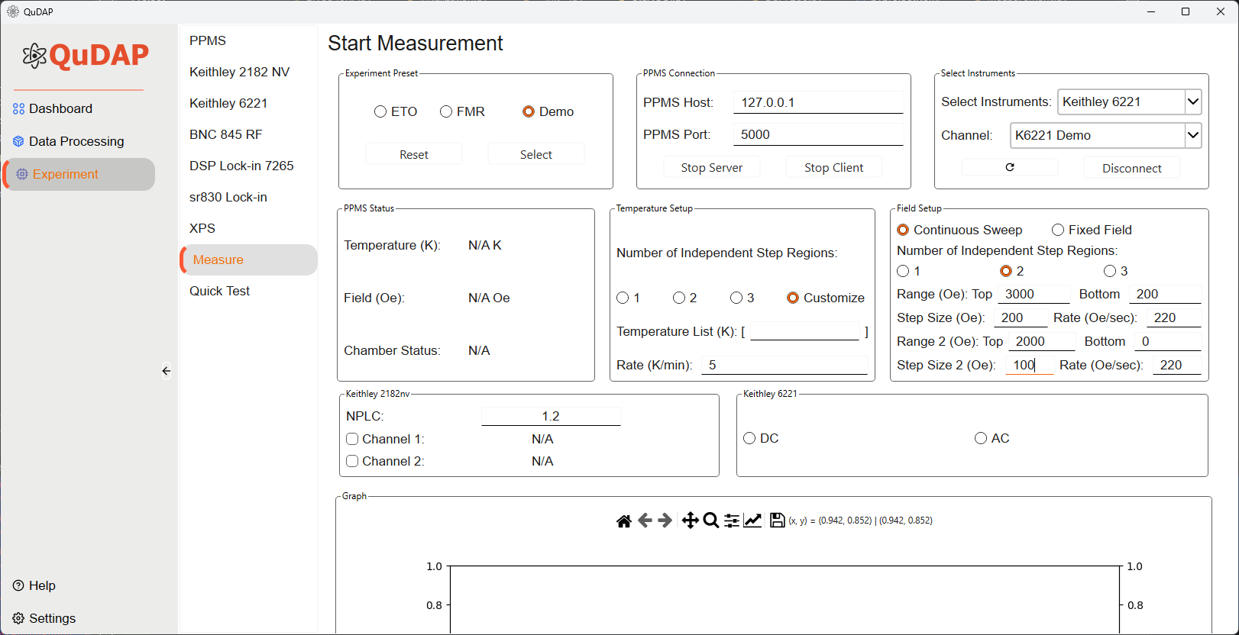
Configure the experiment Field
The software comes with two modes, ‘Continuous Sweep’ or ‘Fixed Field
For continuous sweeping, user will setup the top and the bottom field as well as the rate of the sweeping.
The field will be continuously ramping up or down without stopping
The fixed field configuration is for users who want to have a precise and ordered field reading
The field setting is based on step size which will stable at one field and do the measurement and continuous to next step

Slide 17
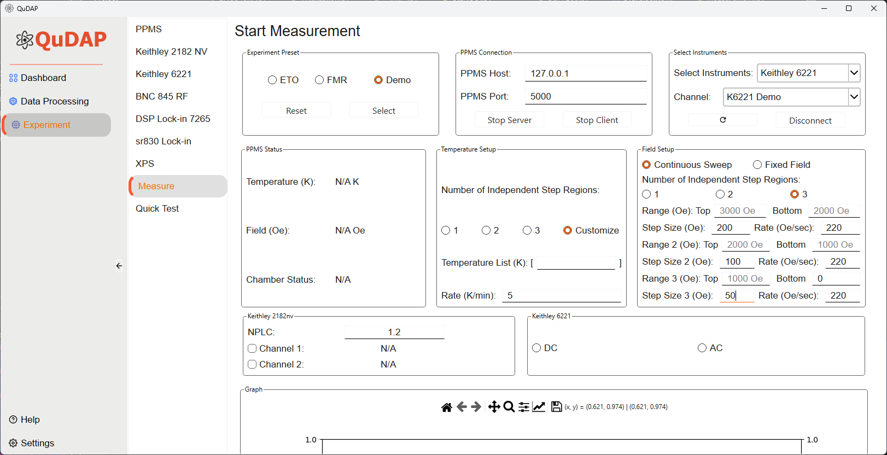
Configure the experiment Field
The software comes with two modes, ‘Continuous Sweep’ or ‘Fixed Field
For continuous sweeping, user will setup the top and the bottom field as well as the rate of the sweeping.
The field will be continuously ramping up or down without stopping
The fixed field configuration is for users who want to have a precise and ordered field reading
The field setting is based on step size which will stable at one field and do the measurement and continuous to next step

Slide 18

Use this setup for demo purpose
Configure the experiment Field
The software comes with two modes, ‘Continuous Sweep’ or ‘Fixed Field
For continuous sweeping, user will setup the top and the bottom field as well as the rate of the sweeping.
The field will be continuously ramping up or down without stopping
The fixed field configuration is for users who want to have a precise and ordered field reading
The field setting is based on step size which will stable at one field and do the measurement and continuous to next step

Slide 19
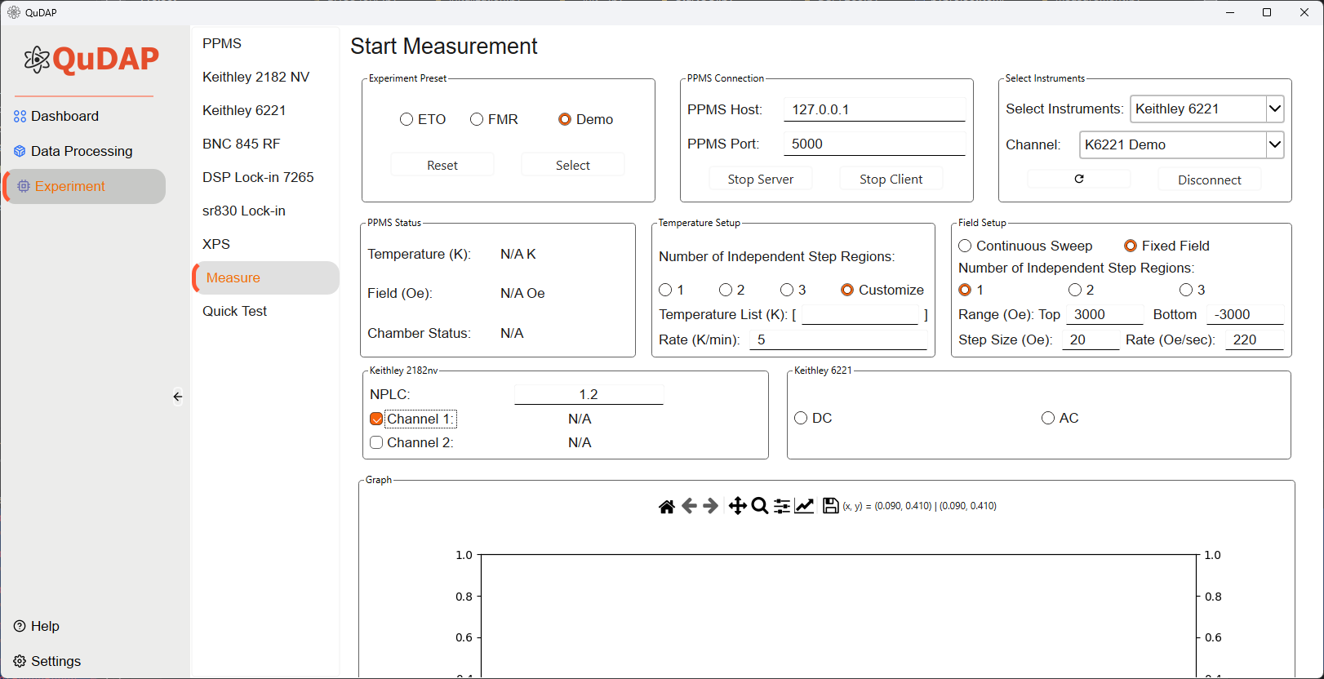
Setup the nanovoltmeter reading – the instrument comes with two channels
NPLC sets up based on instrument manual (1.2 is recommended value)

Slide 20
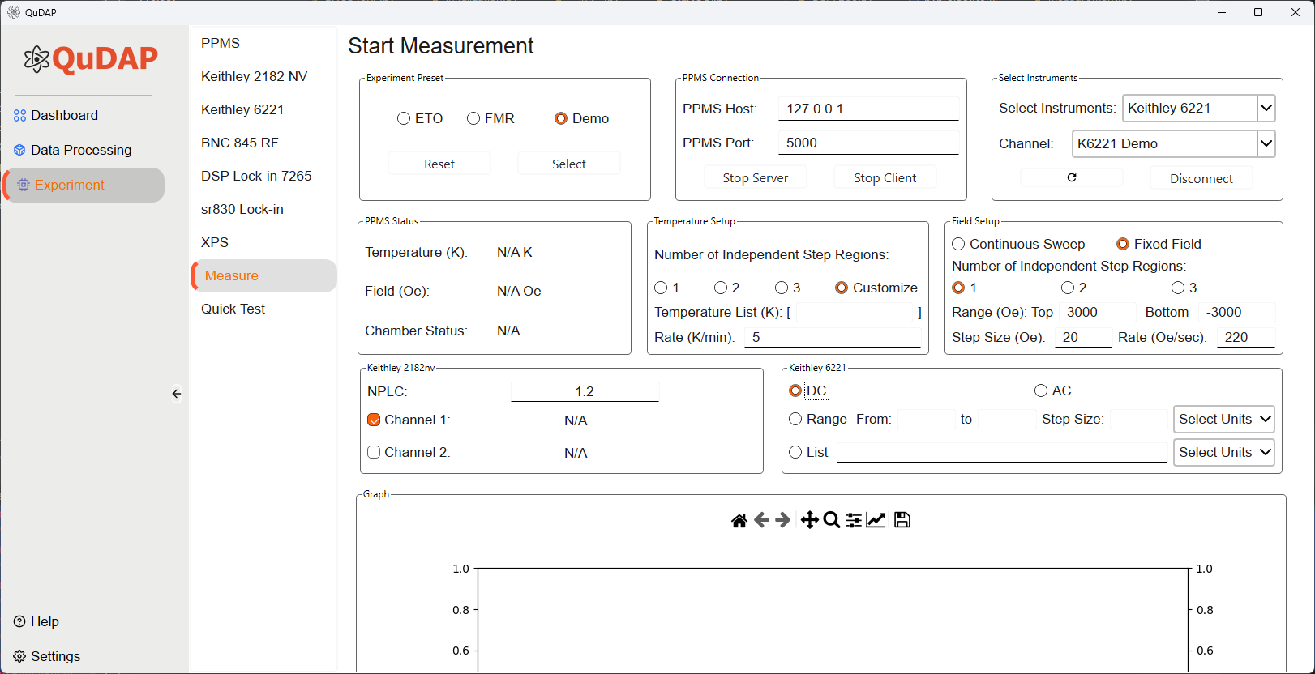
Setup the DC/AC Supply
Now only support DC measurement

Slide 21
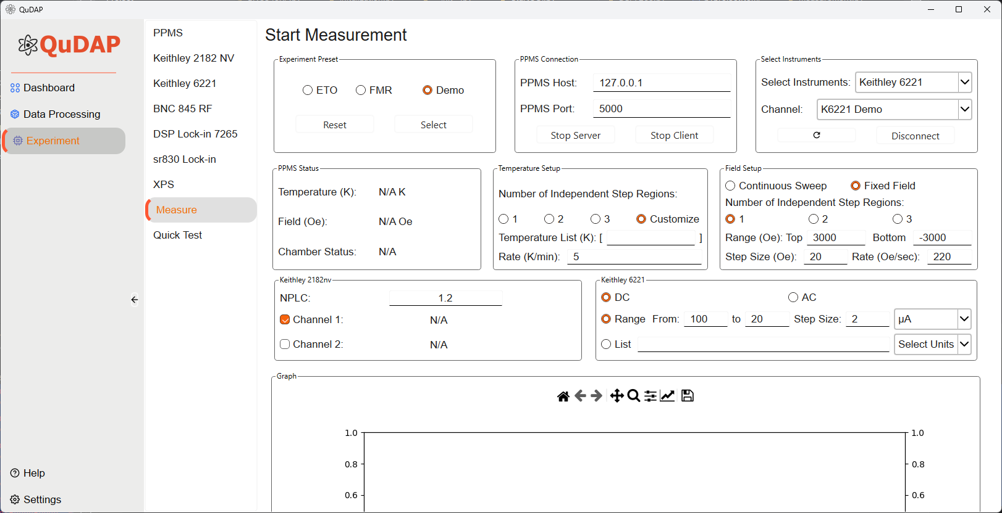
Setup the DC/AC Supply
User can select a uniformly in/decrement range for testing

Slide 22

Use this setup for demo purpose
Setup the DC/AC Supply
Or use the customized values for testing

Slide 23
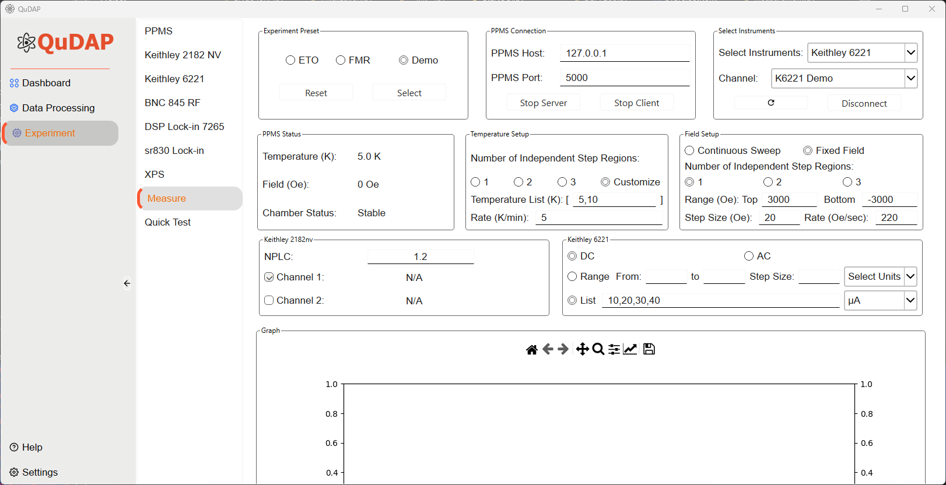
This is the example of final setup for demo

Slide 24
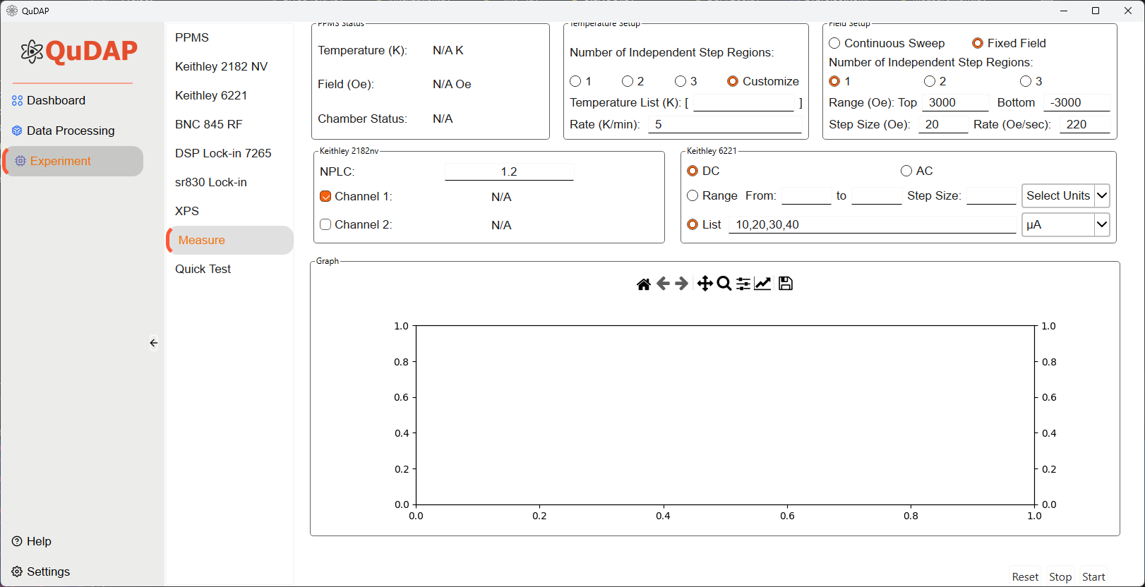
After all the configuration , users can start the measurement by pressing ‘Start’

Slide 25
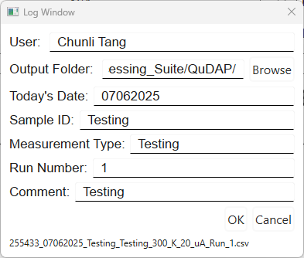
Users must fill out all the information to create the log file for the experiment
Press ‘OK’ to continue
An example of filename will show up at bottom

Slide 26
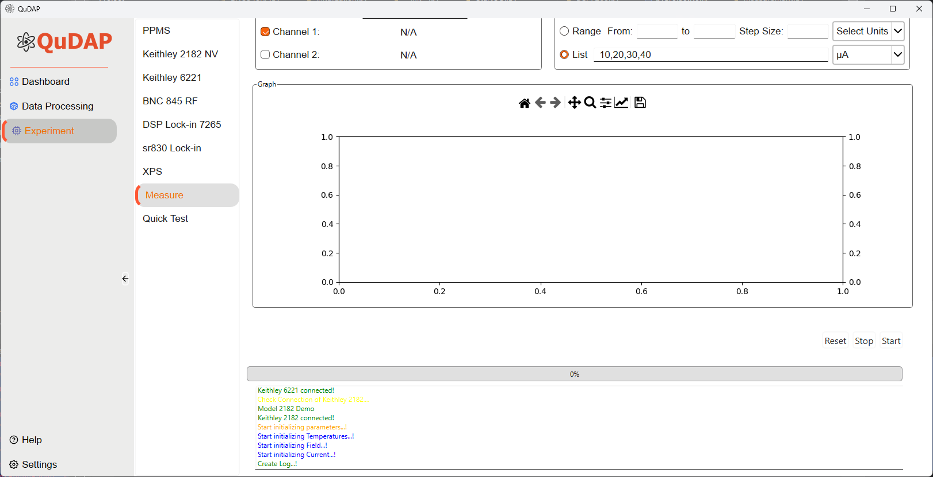
A new text window will show up and showing the current status of the measurement
A progress bar is also being generated to show the current progress

Slide 27
User can also monitor the status of the PPMS in the PPMS Status window

Slide 28
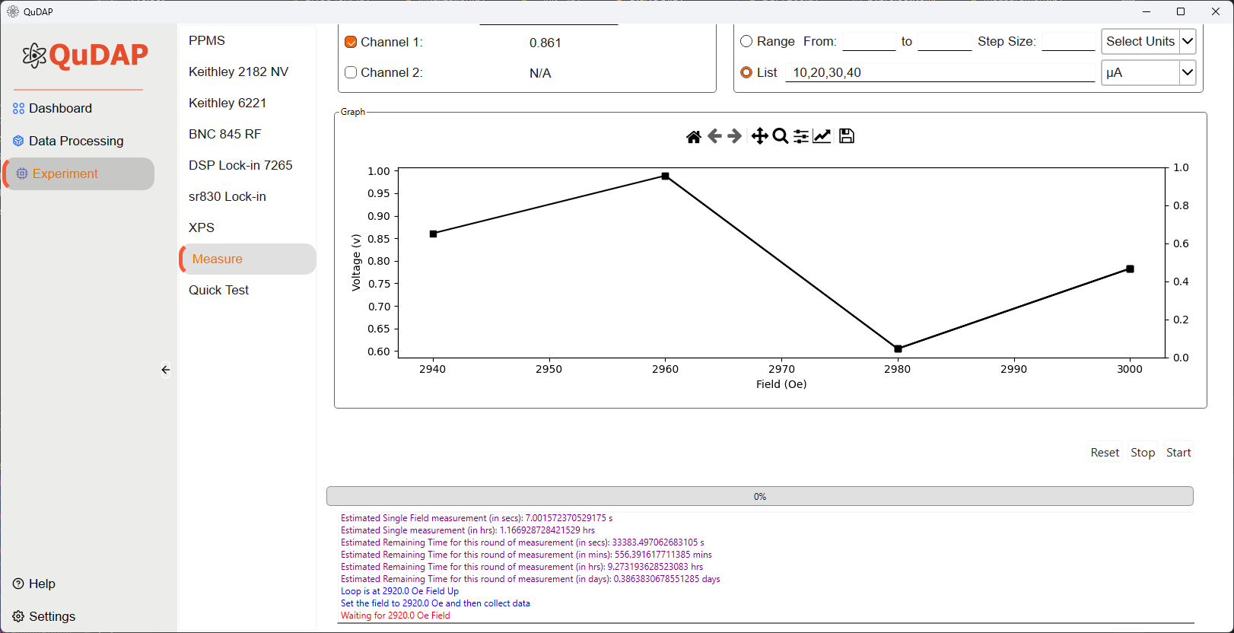
Users can start to monitor the current measurement, and the results can be visualized in plot

